Slide 1
WILL AI BE
COMPLETELY FREE?
(SOON)
What local AI changes, and what it does not
A 10-minute introduction
Notes:
Today I want to ask a simple question: will AI eventually become free? My short answer is almost. The price of using AI may become much less visible, especially when it runs on a device we already own. But the computer, electricity, updates, and responsibility do not disappear. I will explain that idea without going too far into the technical details.

Slide 2


You have probably used AI already
02
ChatGPT
Claude
A question goes in. An answer comes back.
Notes:
I am sure most people in this room have used ChatGPT or Claude before. We open a website or an app, type a question, and get an answer within seconds. That experience feels almost magical because we do not see what happens behind the screen. The important point for this talk is that the answer is being produced on computers somewhere, and someone has to pay for those computers.
Sources and image credits:
- OpenAI design guidelines and logo — https://openai.com/brand/
- Claude icon — https://github.com/simple-icons/simple-icons/blob/develop/icons/claude.svg

Slide 3
Every answer runs somewhere
03
YOU
THE INTERNET
A DATA CENTER
Your question normally leaves your device before the AI can answer it.
That is convenient, but it creates a bill and a privacy decision.
Notes:
With most popular AI services, your question travels through the internet to a data center. Powerful computers there produce the answer and send it back. This is convenient because the company handles the difficult parts for us. But it also means the company pays for every request, and our information leaves our device. That is the system local AI is trying to change.

Slide 4
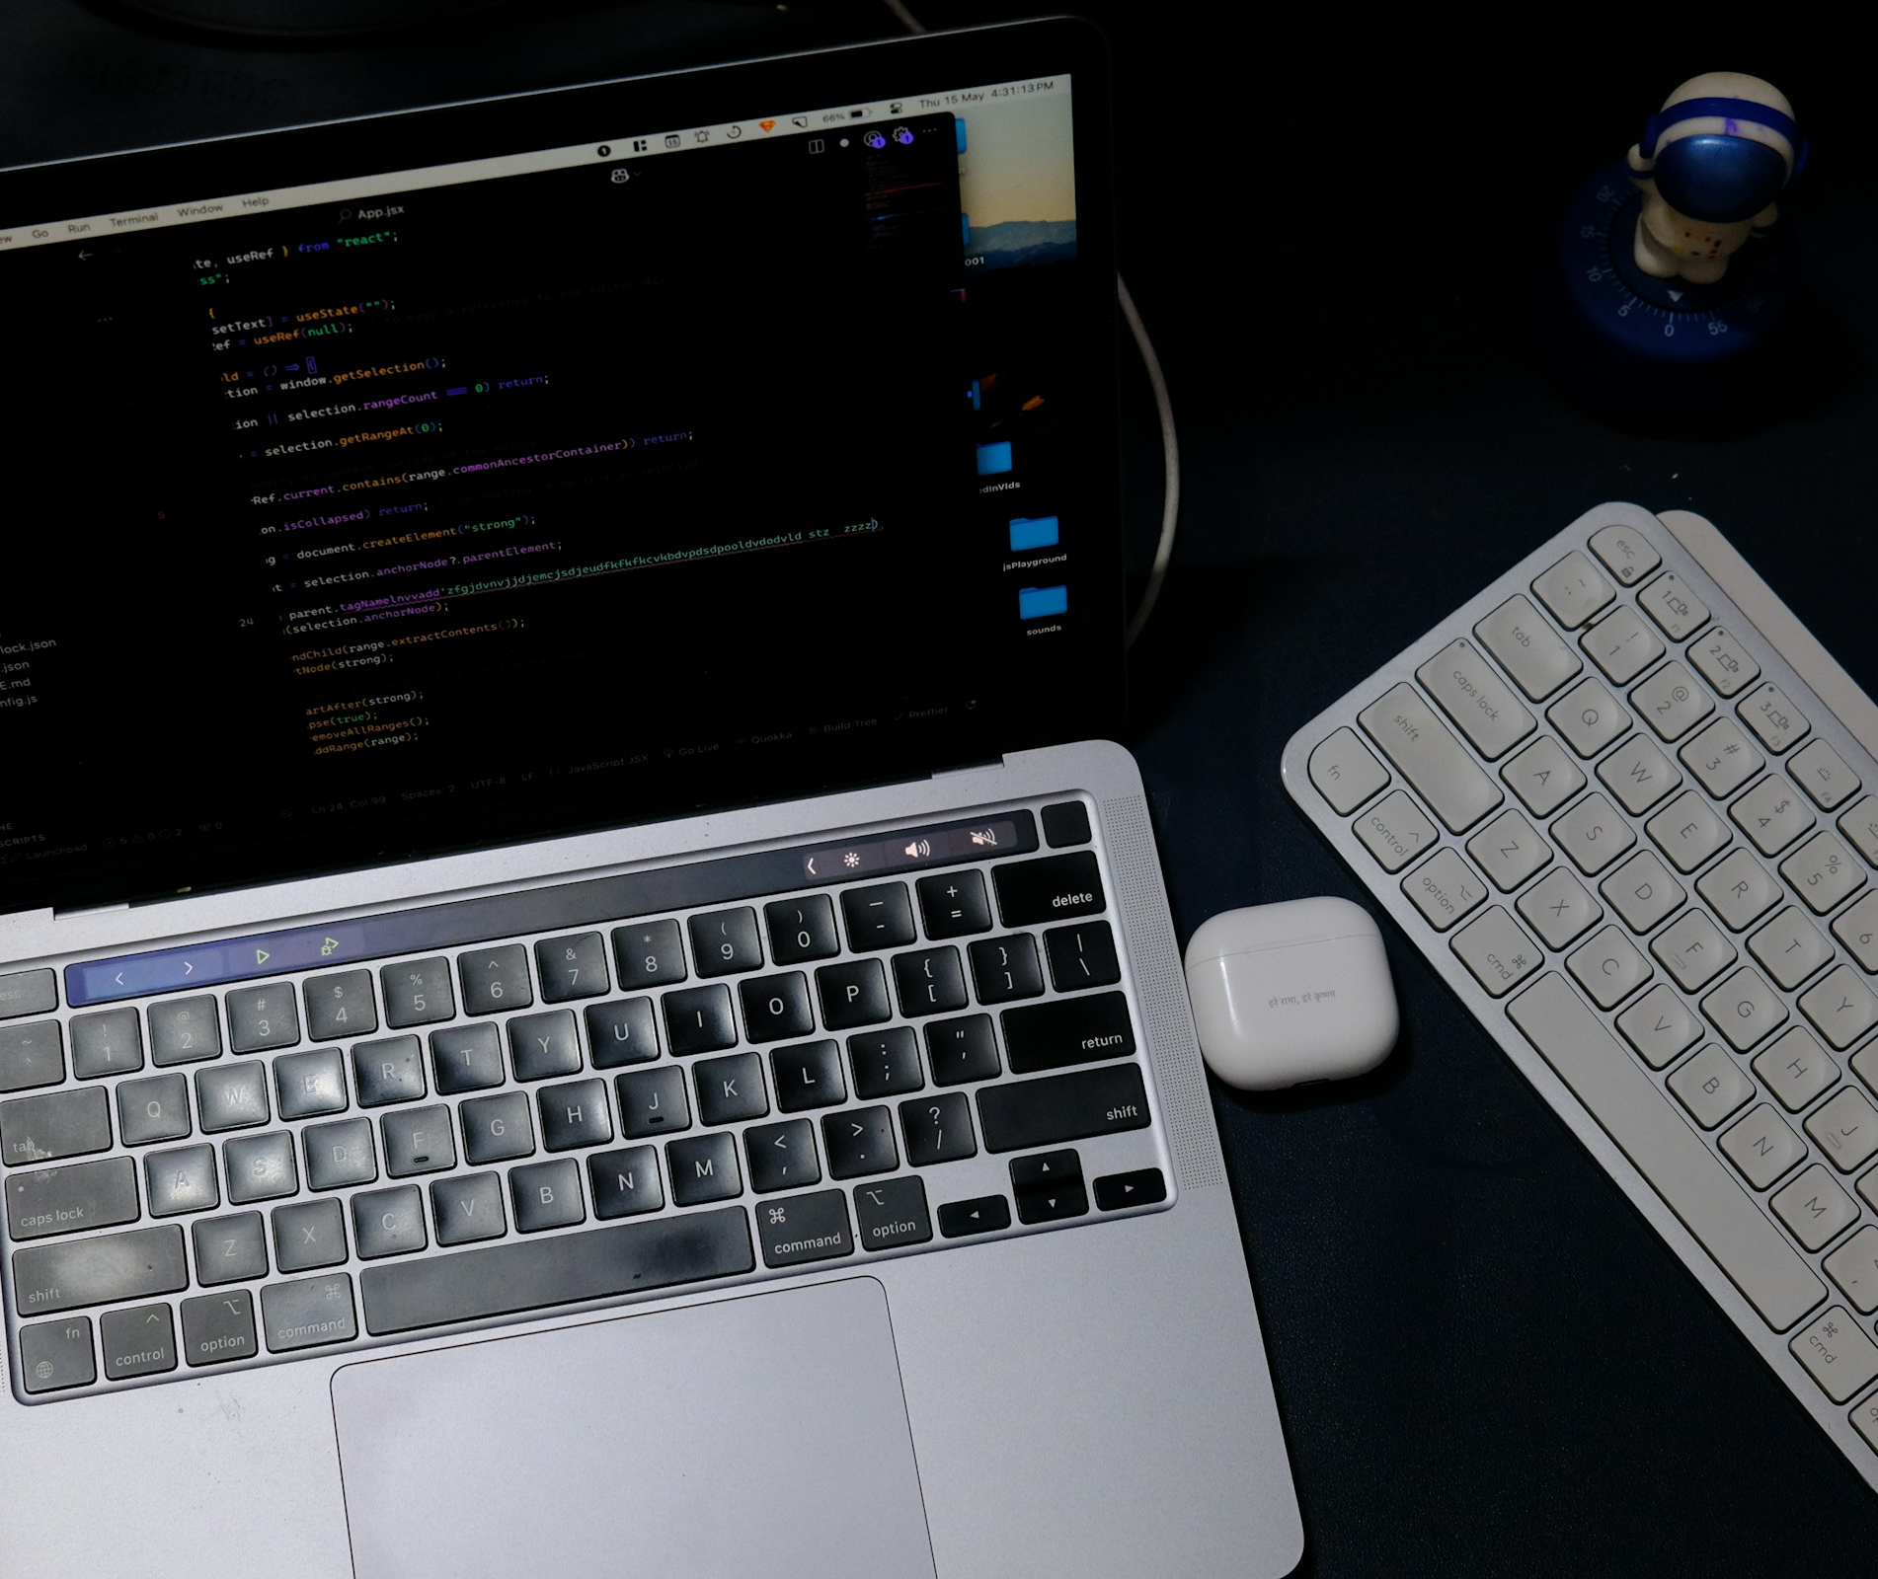
What if the AI lived on your laptop?
04
A local model runs on a device you control.
It can keep working without Wi-Fi, and your files can stay closer to you.
Notes:
A local AI model moves the main work from a company data center onto a laptop, desktop, phone, or private computer that you control. It does not have to be permanently disconnected from the internet. The simple difference is where the answer is produced. If the model runs on your own device, it can work offline and sensitive files do not automatically need to be sent to an outside company.
Sources and image credits:
- Stock photo: Rahul Mishra, Unsplash — https://unsplash.com/photos/laptop-and-keyboard-on-a-dark-desk-BA2ELfOTqJ4

Slide 5



This is already possible
05
Qwen
Kimi
Ollama
Downloadable models
An easy way to run them
You no longer need to build an AI company to try a model on your own computer.
Notes:
Local AI is not a distant idea. Families such as Qwen and Kimi provide models that people can download. Software such as Ollama makes some of those models much easier to run. You do not need to memorize these names. They simply show that an alternative to renting every answer from a large provider already exists, although the largest models still need expensive hardware.
Sources and image credits:
- Qwen official repository — https://github.com/QwenLM/Qwen
- Kimi official branding guide — https://github.com/MoonshotAI/Branding-Guide
- Ollama official repository and logo — https://github.com/ollama/ollama

Slide 6
Why people want local AI
06
01
Private files can stay closer to you
02
It can work without an internet connection
03
There is no new bill after every question
Notes:
The attraction is easy to understand. First, private notes and files can stay on a machine we control. Second, the model can keep working when the internet is slow or unavailable. Third, after the model and computer are ready, asking one more question usually does not create another visible fee. These advantages matter most for frequent, ordinary tasks rather than the hardest possible questions.

Slide 7
Could it feel free?
07
ILLUSTRATIVE
Cloud is cheap to start.
Local can become cheaper when you use it often.
Relative cost, not real prices
Notes:
This chart is only an illustration, not real pricing data. Cloud AI is usually cheaper and easier at the beginning because we do not need to buy special hardware. Its cost grows as we use it more. Local AI has a larger starting cost, but each extra request can become very cheap. That is why local AI may feel free to a frequent user even though the machine itself was never free.

Slide 8
Free to use is not free to own
08
THE COMPUTER
Someone bought it
The price moves.
It does not vanish.
ELECTRICITY
Every answer still uses power
UPDATES AND TIME
Someone keeps it working
Notes:
The word free can hide costs. A computer had to be purchased. It consumes electricity. Models and software need updates, and someone spends time fixing problems. At home, we often ignore that work because we do it ourselves. In a company, it becomes staff time and risk. So local AI changes where the cost appears. It does not make the cost disappear.

Slide 9
Local is not always better
09
LOCAL
CLOUD
Better for private files
Useful without Wi-Fi
Good for repeated everyday work
Stronger on difficult questions
Easier to keep up to date
Ready for many users at once
The right choice depends on the job.
Notes:
Local AI is useful, but cloud services still have major advantages. A company can run much larger systems, connect them to current information, and serve many users at once. Local AI works best for private, repeated, or offline tasks. The cloud works best when we need the strongest model or the newest information. There is no single winner for every situation.

Slide 10
Privacy has an asterisk
10
*
A local model can still send information out through:
Plugins and connected tools
Cloud backups
Saved logs and history
Local helps privacy, but settings and habits still matter.
Notes:
Local AI can protect privacy, but the word local is not a guarantee. A connected plugin may send information to another service. A cloud backup may copy files off the device. Saved logs can keep sensitive prompts. The safer question is not simply, ‘Is the model local?’ It is, ‘Where does the information travel from beginning to end?’

Slide 11
The bad side
11
01
Spam and scams become cheaper to produce
02
People may use unapproved AI on private work
03
Cheaper AI can mean more total energy use
More access also spreads more responsibility.
Notes:
Wider access has a negative side. If private AI becomes cheap, it also becomes cheaper to create spam, scams, and harmful automation. Employees may run unapproved models on sensitive company information. And when every device can generate more, efficiency may increase total use rather than reduce it. Making AI more available is valuable, but it also spreads responsibility beyond a few large companies.

Slide 12
The likely future
12
ON YOUR DEVICE
IN THE CLOUD
Everyday questions
Private work
Offline use
ONE
ASSISTANT
Hard questions
Current information
Large shared tasks
The app chooses where each request should run.
Notes:
The most realistic future is a mixture of local and cloud AI. Everyday questions, private documents, and offline tasks can stay on the device. Difficult questions, current information, and large shared jobs can go to the cloud. To the user, it may still look like one assistant. The important issue is whether we can see and control when our information leaves the device.

Slide 13
SO, WILL AI BE
COMPLETELY FREE?
ALMOST.
The price per question can disappear.
The real costs do not.
13
Notes:
So, will AI be completely free? It may feel almost free for everyday use. If the model runs on a computer we already own, the visible price after each question can disappear. But somebody still pays for the hardware, electricity, updates, security, and mistakes. The real change is not that intelligence costs nothing. The change is that more people may own the tool and decide where their information goes.

